Slide 1
Simplify MLOps for Everyone
Hackathon FY 22

Slide 2
Ideation
Create a simplified process
Build accelerator
Can we use Hand gesture to trigger mlops
Can we use voice to trigger mlops
Completely automated process
Can we use that as hackathons for customer
Can we make it part of innovation lab

Slide 3
Data Science Development process

Slide 4
Training Pipeline Automation

Slide 5
Deploy

Slide 6
MLOps

Slide 7
IT Teams Involved
Networking
Security
Strategy/EA
Technical Architecture
Solution Architecture
DevOps/Release
Management
Planning
Budget
Business Analyst

Slide 8
Data Science Team
Data engineers
Data scientists
AI engineers – writing code for devops
AI/ML Architecture
AI/ML Business Analyst
SME – Usually business folks based on use case
Directory
CDO

Slide 9






How the roles function in - Customer
RACI
 | Data Scientist | Business SME | Data Engineer | Business Owner | ML Engineer/CI/CD | IT – Azure/ Security
Data Engineering
ML Model
Prod Code
MLOps
Business analyst/ Validate
Prod Deploy
RACI
C
C
R
I
I
R
I
A
I
I
Matrix
I
I
C
I
R
I
If you take a look at the RACI chart for EDSP you’ll notice two things immediately – first, the Account team is involved in every stage in the process, they should never be kept out of the loop. Second, accountability for the process is spread across several different roles, so teamwork and communication is essential. Although there are certain prescribed points information handoff, this process will work best with non-sensitive information being granted as freely as possible to all involved.
I
A
I
R
C
I
R
A
C
I
C
A
Responsible
Accountable
Consulted
Informed
Notes:
Customer Resources for EDSP to be successful
Roles are all from customer side
Left side is all functionality or various stages or departments of data science

Slide 10
Tasks
Define use case
Collect Data Sources
Document Data sources – Data dictionary
Data engineering
Data Science modelling
Validate if use case/data has possibility to continue
Create code for MLOps
Training code
Evaluate code
Register model
Batch/Realtime inferencing code, AKS,ACS, Batch
Create DevOps Pipeline to push through environment
Store Data engineered data set – feature store for others to use
Document the entire Data science process
Setup Monitoring for Model inferencing and –Re-Training
Dashboard on Model performance
Deploy model to model marketplace – Sharable for other inside enterprise
Customer support

Slide 11
MLOps Technology Task
Architecture/Security approval
Networking to connect to enterprise data
Design and Implementation Guidelines
Data Science Development environment
For Data engineer/ data scientists/ AI engineer
DevOps/MLOps Dev, QA and Prod environments
Build Each Environment Pipeline – Generalized
Security on all the environments
Design and Implementation guide
Dependent system – Design and implementation guidelines
Monitor – for ML Operations – AOC – Analytics operation center
Backup and restore
HA/DR
Performance
Cost
Timeline and budget
Customer support

Slide 12
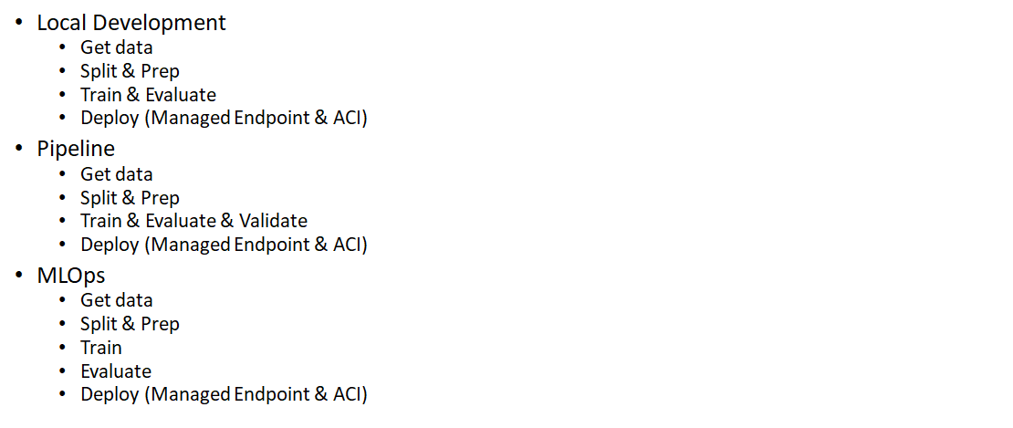
Basic Model Development

Slide 13
AutoML Model Developent

Slide 14
Outcome
Create ML open hack
Build Solution Accelerator
Single Click deployable solution(Subject to customer review)
Document the Security and process for above accelerator
Deploy with customers – KPI (How many deployed)

